Slide 1

MICRON – HF WASTEWATER TREAMENT
SIMULATION & BENCH TESTING – Dec 2021
Siva Kumar Kota/Chun Yew
Hiep Le/Sankar
Part 5

Slide 2
^{Option 7 -} NF270 followed by SWRO with 800 ppm of F, ammonia -207 ppm (separate sludge)
F: 150 m3/hr
NF270
SWRO
Polishing Filters
Treated Water
UF
HF WW
Coagulation, Clarifier
Coagulation, Clarifier
CaF2 sludge
Phosphate sludge
2

Slide 3
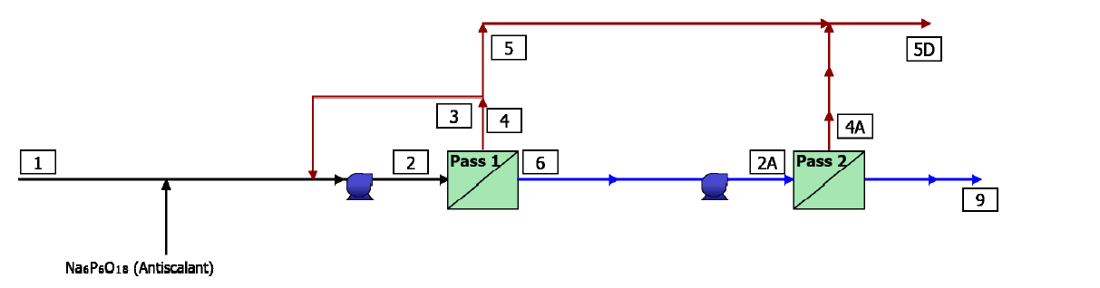
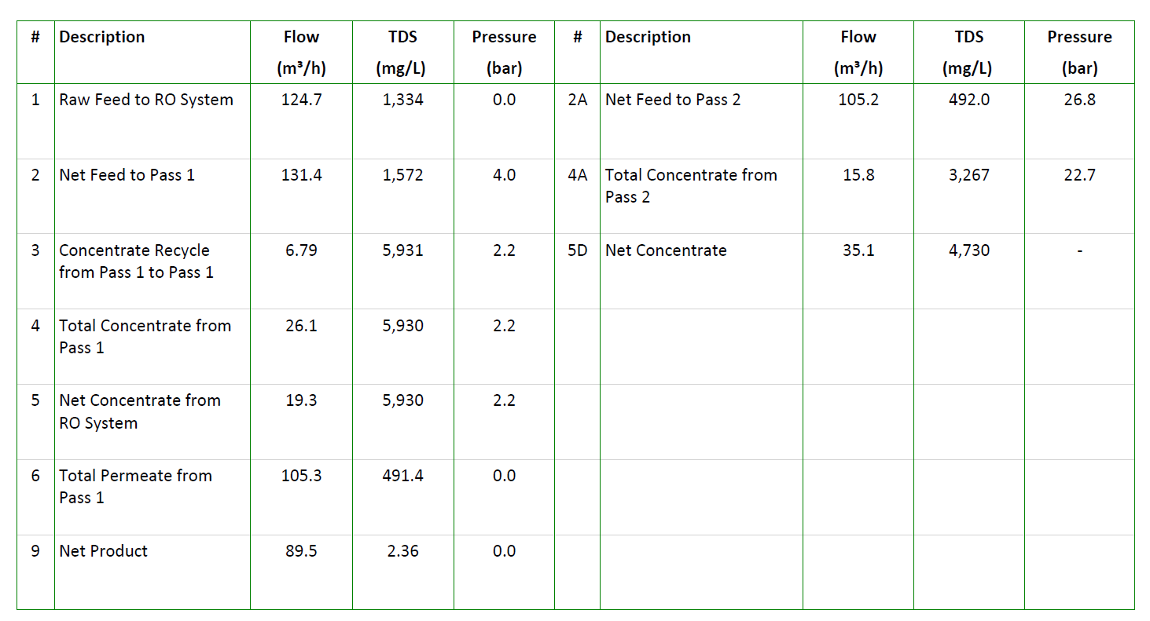
^{Option 7 -} NF270 followed by SWRO with 800 ppm of F, ammonia -207 ppm (separate sludge)

Slide 4
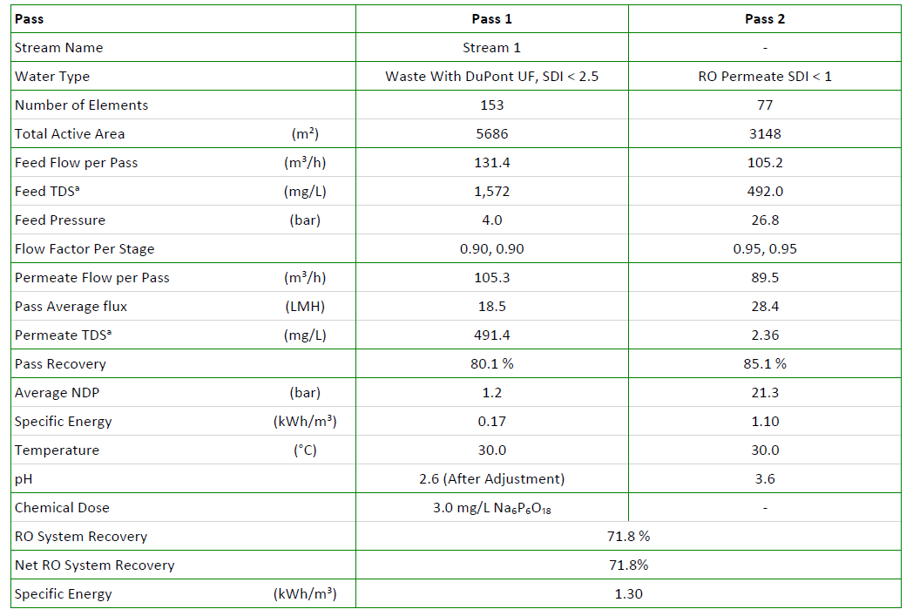
^{Option 7 -} NF270 followed by SWRO with 800 ppm of F, ammonia -207 ppm (separate sludge)

Slide 5
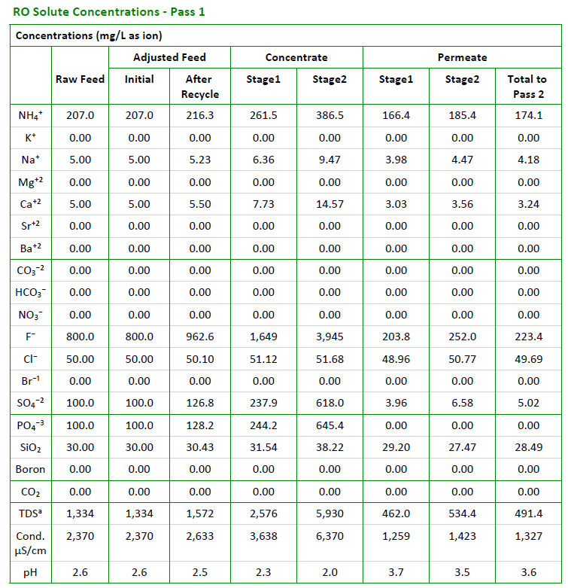
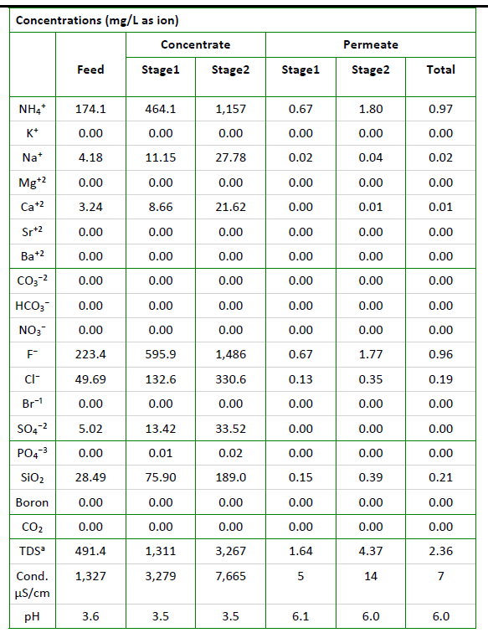
^{Option 7 -} NF270 followed by SWRO with 800 ppm of F, ammonia -207 ppm (separate sludge)
NF270
SWRO

Slide 6
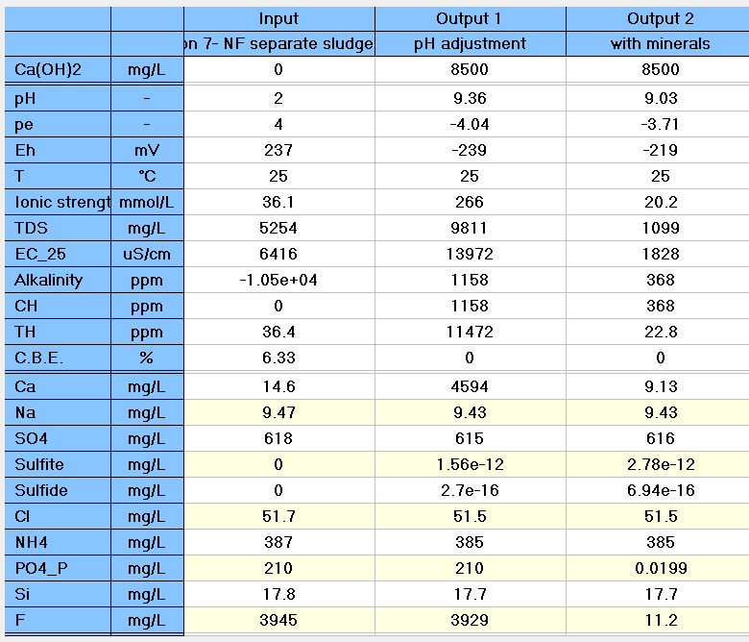
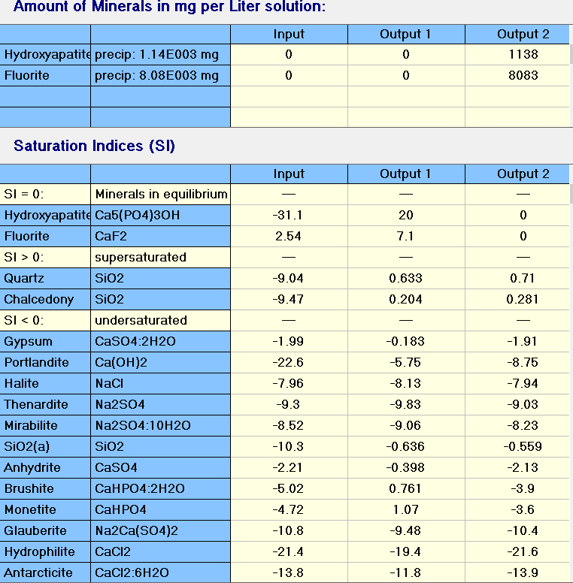
Option 7- NF270 Separate Sludge
>80% CaF2

Slide 7
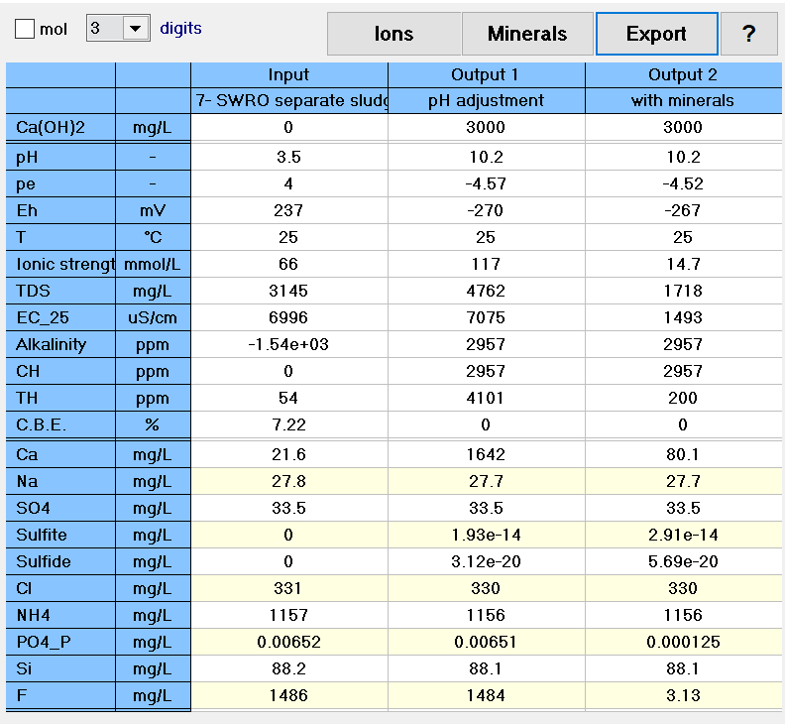
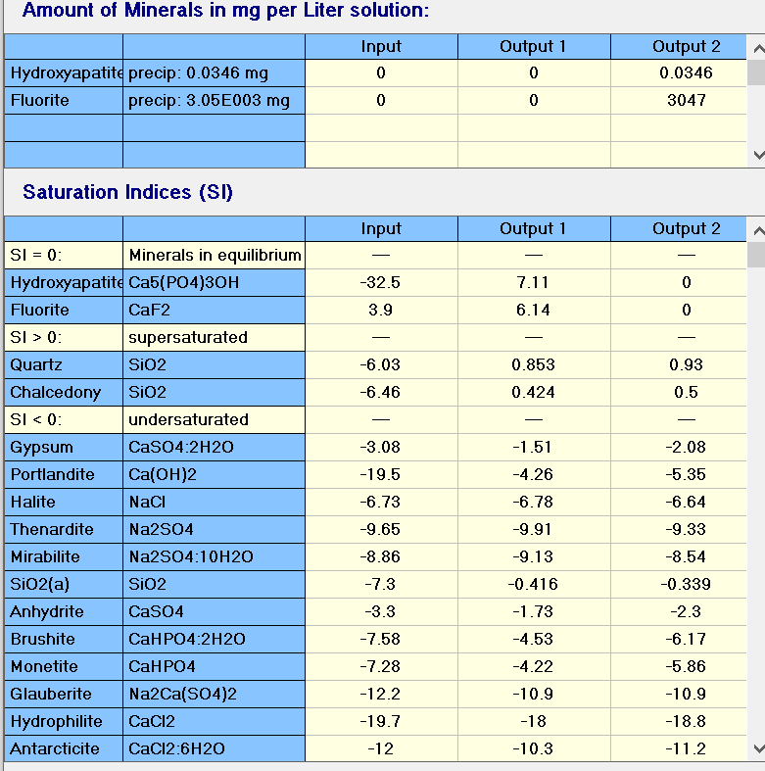
Option 7- SWRO Separate Sludge
>80% CaF2

Slide 8
^{Option 7a -} NF270 followed by SWRO with 800 ppm of F, ammonia -207 ppm (Combined sludge)
F: 150 m3/hr
NF270
SWRO
Polishing Filters
Treated Water
UF
HF WW
Coagulation, Clarifier
Coagulation, Clarifier
CaF2 sludge
Phosphate sludge
8

Slide 9
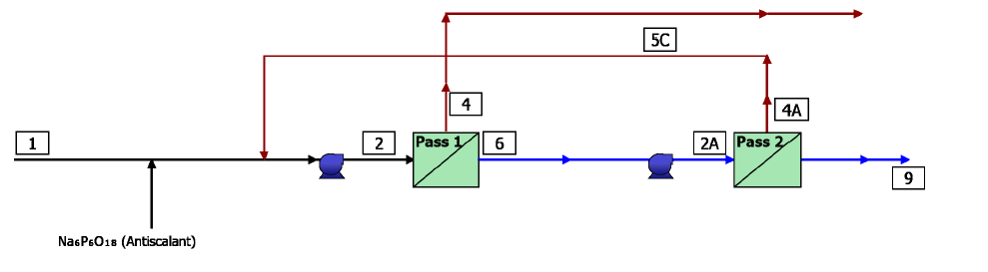
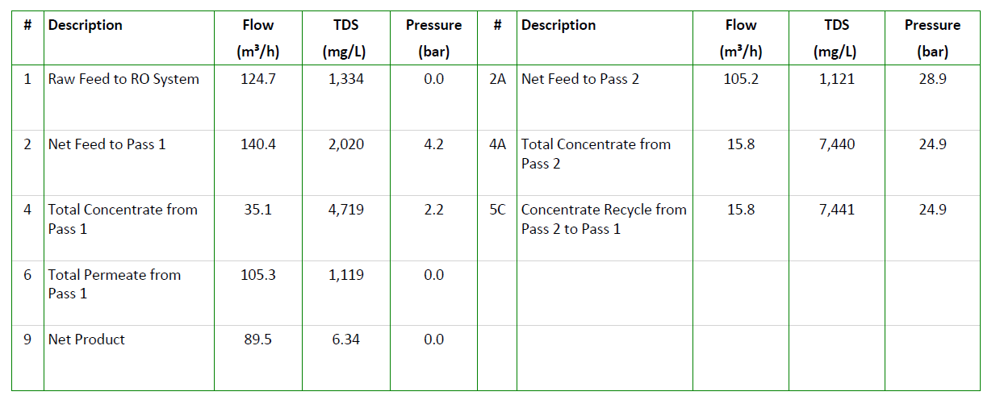
^{Option 7a -} NF270 followed by SWRO with 800 ppm of F, ammonia -207 ppm (Combined sludge)

Slide 10
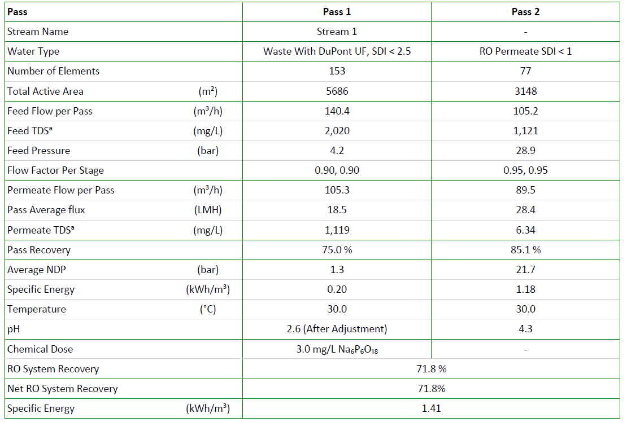
^{Option 7a -} NF270 followed by SWRO with 800 ppm of F, ammonia -207 ppm (Combined sludge)

Slide 11
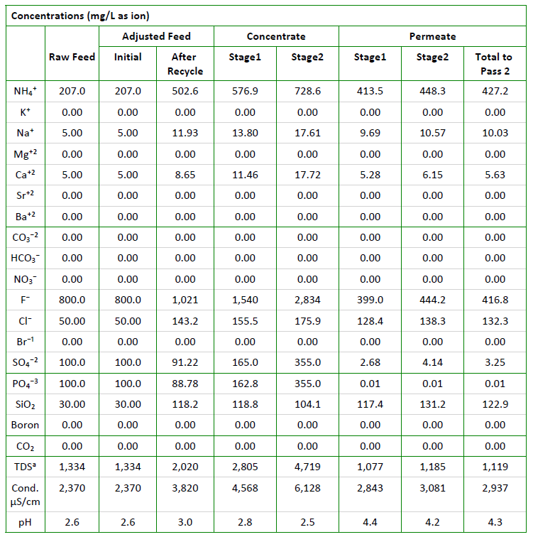
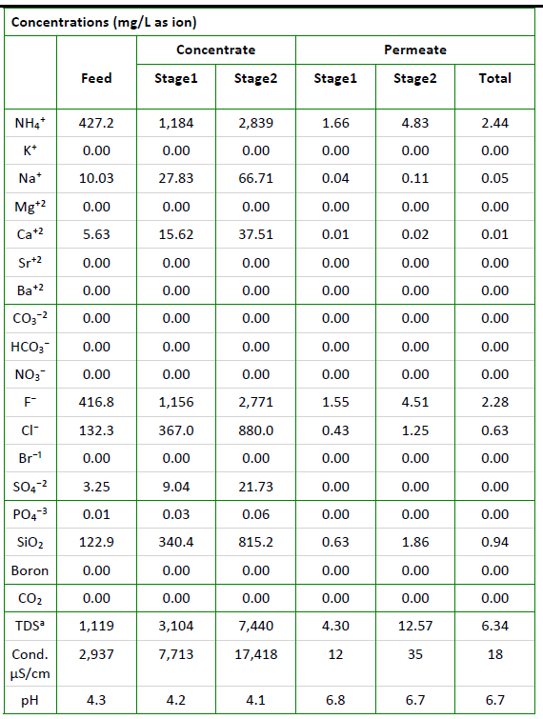
^{Option 7a -} NF270 followed by SWRO with 800 ppm of F, ammonia -207 ppm (Combined sludge)
NF270
SWRO

Slide 12
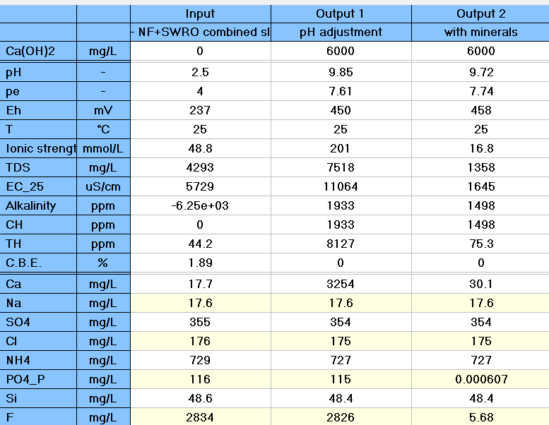
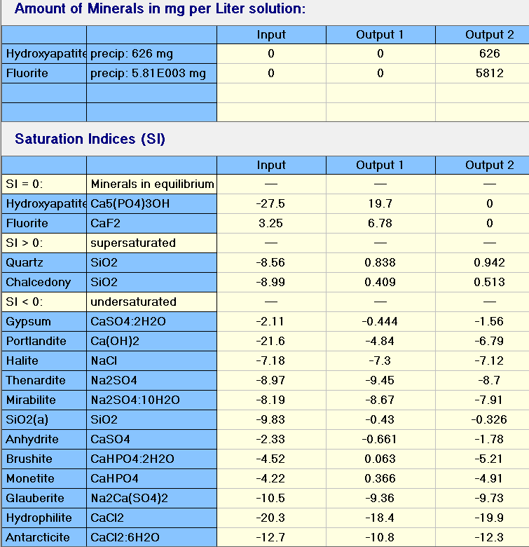
Option 7a- Combined Sludge
>80% CaF2

